Slide 1
Iterators in Python
DVT101 – Lecture 41
- By Dataverse Tutorials

Slide 2
What are Iterators in Python?
Meaning of iteration in programming
Traversing elements one by one
Iterator vs normal collection
Core idea of sequential access

Slide 3
Iteration vs Indexing
Sequential access vs random access
Why not always use indexing
Performance and memory perspective
Use cases of iteration

Slide 4
Iterable Objects in Python
What is an iterable
Common iterable examples
Ability to produce an iterator
Role in for-loops

Slide 5
Iterator Objects in Python
What is an iterator
Stateful traversal concept
One-direction movement
Iterator exhaustion

Slide 6
Iterator Protocol (Internal Working)
Role of iter method
Role of next method
How Python fetches next element
End-of-sequence signaling

Slide 7
How for-loop Uses Iterators
for-loop internal mechanism
Implicit use of iter and next
StopIteration handling by loop
Why for-loop never crashes

Slide 8
Why Do We Need Iterators?
Lazy evaluation concept
Memory efficiency
Large data processing
Streaming-style computation

Slide 9
Built-in Iterators (Concept)
Strings as iterables
Lists and tuples iteration
Dictionaries iteration behavior
Uniform iteration design

Slide 10
next() Function Concept
Manual iteration control
Fetching elements one by one
Iterator state update
Error at iteration end

Slide 11
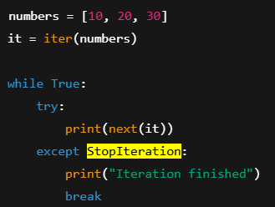
StopIteration Exception
Purpose of StopIteration
How Python uses it internally
Safe loop termination
Manual handling idea

Slide 12
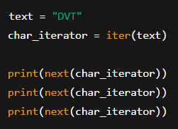
Program Concept: Built-in Iterator Example
Converting iterable to iterator
Fetching elements sequentially
Iterator exhaustion behavior
Practical usage scenario

Slide 13
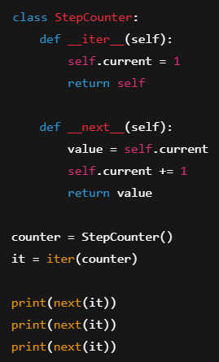
Custom Iterator: Why & When
Need for custom iteration logic
Controlled sequence generation
Infinite or dynamic sequences
Industry-level use cases

Slide 14
Custom Iterator Design Flow
Class-based iterator design
Maintaining internal state
Reset and progression logic
Protocol compliance

Slide 15
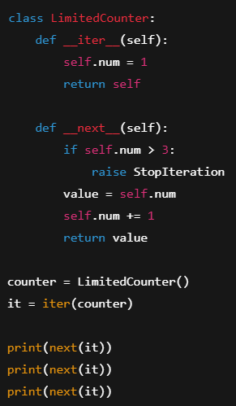
Program Concept: Custom Iterator
Defining iter behavior
Defining next behavior
Updating state per call
Continuous iteration idea

Slide 16
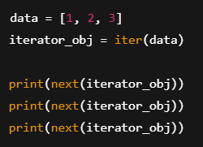
Iterator vs Iterable
Conceptual difference
Capability comparison
Who controls iteration
Common confusion points

Slide 17
Real-world & Industry Use Cases
Data streaming pipelines
Machine learning batch loading
Log processing systems
Large file handling

Slide 18
Summary & Key Takeaways
Iterator protocol recap
Memory-efficient looping
Custom iteration power
Foundation for generators

Slide 19


